Slide 1
Project Presentation
Library

Slide 2
Requirements
Requirements
Adding a new user to the User List in the Library
Adding a new book to the Book List in the Library
User checks-in a book from the Library
User returns a book to the Library
User holds a book
Searching for a book
Deleting a book from the Book List
Removing a hold on a book
Renewing a book
Printing user’s transactions

Slide 3
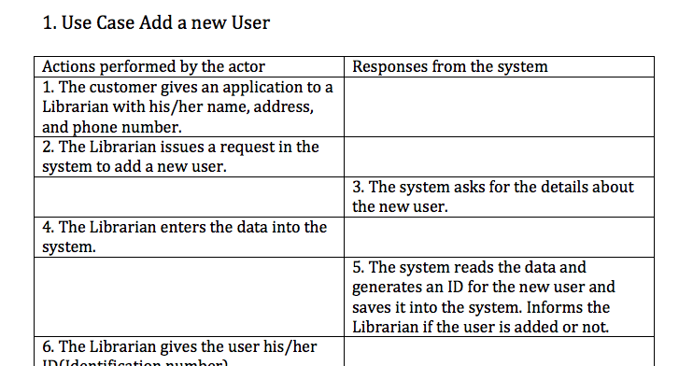
Use Cases

Slide 4
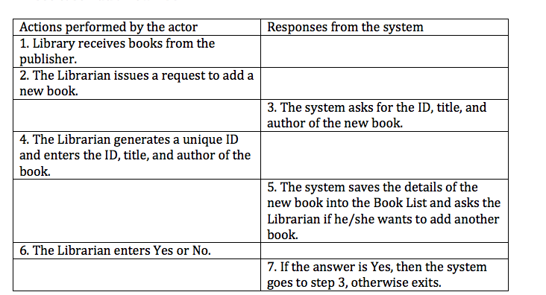

Slide 5
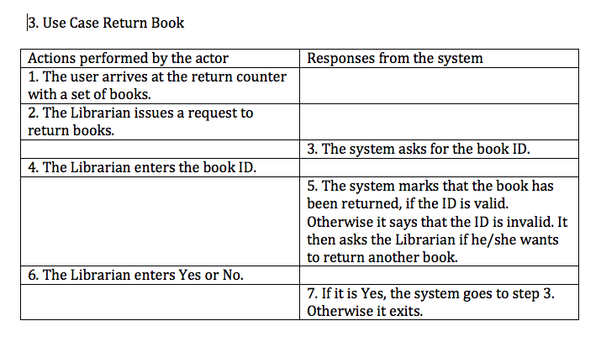

Slide 6
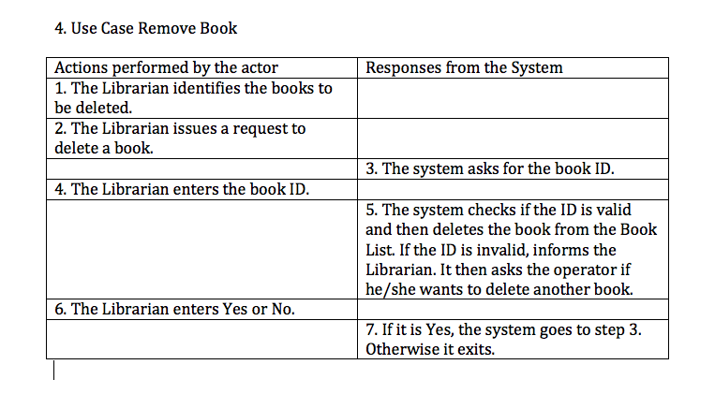

Slide 7
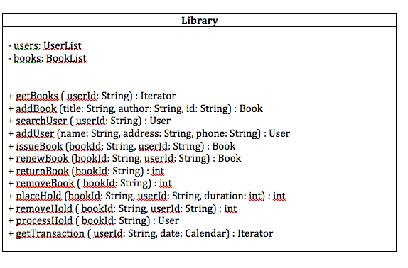
Design Class Diagrams

Slide 8
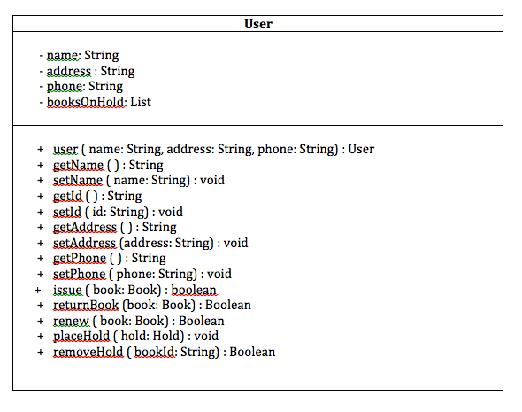

Slide 9
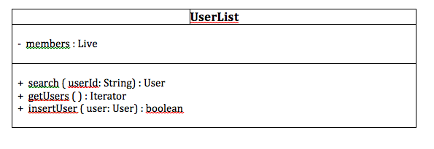

Slide 10
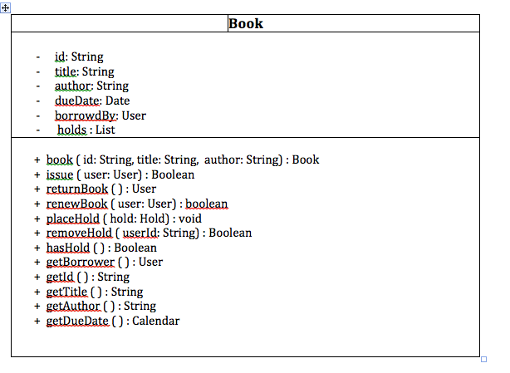

Slide 11
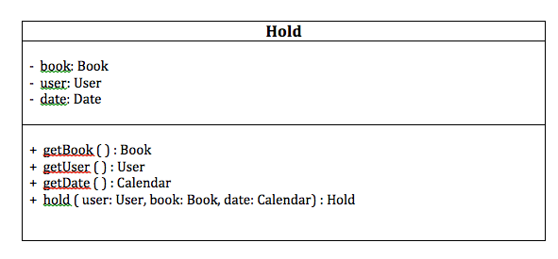

Slide 12
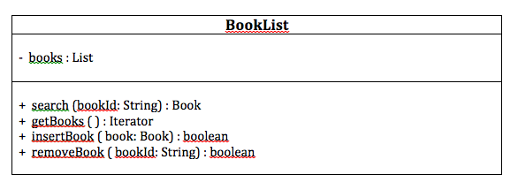

Slide 13
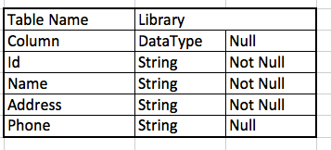
DB Table Design

Slide 14
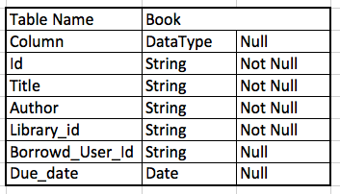

Slide 15
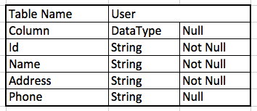

Slide 16
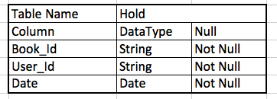

Slide 17
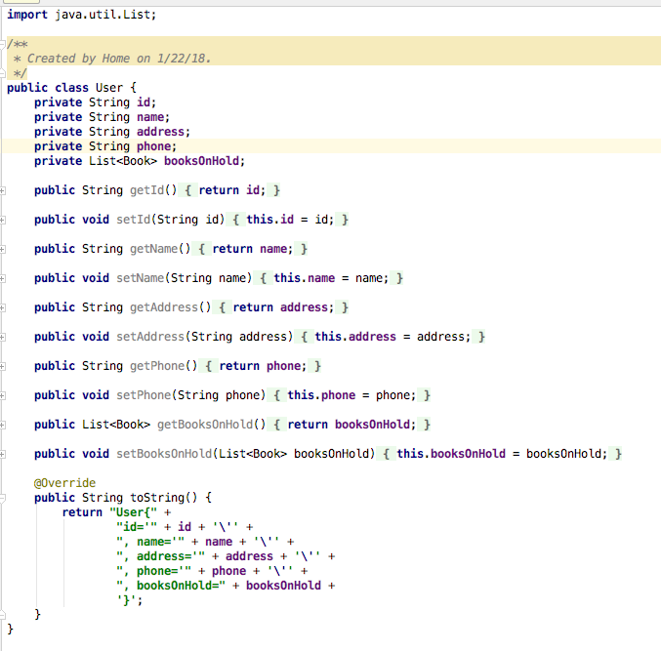
Java- Classes

Slide 18
